Slide 1

Final Year Project/Major Project
“Android Based Solar Grass Cutter with MPPT System and Sprinkle System”
Project Guide:
Asst. Prof Neeraj Sharma
(Department of Electronics and Communication Engineering)
Project Coordinator
Dr. Nimish Srivastava
(Department of Electronics and Communication Engineering)
Prepared By – Group PEC 3.14
Shivanshu Singhal (1900270310170)
Shubham Kr. Singh (1900270310175)
Saurabh Singh (1900270310156)
Sarvik Singh (1900270310153)
Submitted to:
Gp. Capt. (Dr) PK Chopra(R), VSM
HOD ECE & EI
Ajay Kumar Garg Engineering College, Ghaziabad
Dr A.P.J. Abdul Kalam Technical University, Lucknow

Slide 2
Problem Statement
Our Problem Statement for the Project :
Classical grass cutters with heavy engines create noise pollution and local air pollution due to the combustion in the engine.
If the electric grass cutter is corded, moving could prove to be problematic and dangerous.
Moving the grass cutters with a standard motor is inconvenient, and no one takes pleasure in it.
Motor powered engines require periodic maintenance such as changing the engine oils etc.
Solar ways grass cutters are environment friendly.

Slide 3
Hypothetical Solutions
We are designing this smart grass cutter system that puts forth a completely automated/user controlled lawn mower mechanism.
The robotic vehicle is equipped with a grass cutter blade that allows for grass cutting at high RPM. The system has a smart functionality that allows it to cover the complete area of a lawn or garden by moving in a zigzag manner in order to cover the entire area.
We are integrating a novel solar tracking system, where the solar panel is coupled to servo motor which tracks the sun so that the solar panel remains inclined towards the sun, most of the time of the day.
We are also imparting a water sprinkler system in order to water the lawn and settle the soil which erodes due to high rpm of blades.

Slide 4
Comparative Analysis
Traditional Model
New Model
Noise Level: Produces around 90 decibels and a chainsaw about 110 decibels. Hence performing grass-trimming operation in a group can cause both temporary and permanent noise-induced hearing loss.
Air Pollution: Two-stroke engines are terribly inefficient in terms of fuel burning, with about 30% of engine fuel failing to undergo complete combustion. This produces carbon monoxide, nitrous oxide, and hydrocarbons.
Noise Level: Electric lawn mowers and lawn equipment run at around 75 decibels. Electric lawn mower will reduce noise pollution (and annoyance) by 50-75%.
Air Pollution: Since they work on cleaner energy of solar cells and hence are not accountable for any/no air pollution.

Slide 5
Comparative Analysis
Traditional Model
New Model
Periodic maintenance and service is required.
These are required to move mechanically by the user.
The user needs to come in contact of harmful gases and chemical. And have to manually work in any weather conditions.
Only one mover can be controlled one at a time.
No or zero maintenance is required and better life.
These are controlled automatically either by gestures, mobile, remote or voice.
The user can control the mover remotely from any place and do not have any health hazards.
Multiple mover can be controlled simultaneously using IoT.

Slide 6
Working
The smart grass cutter system puts forth a completely automated lawn mower mechanism.
The robotic vehicle is equipped with a grass cutter blade that allows for grass cutting at high RPM.
This efficient system uses a microcontroller based circuit in order to achieve this functionality. It is a battery operated system that uses 2 batteries.
One battery is used to run the vehicle movement DC motors and the other one is used to power the grass cutter motor.
Also the system uses a solar panel to demonstrate the charging of vehicle movement battery.
The Arduino Uno reads the instruction given through the Bluetooth Module.

Slide 7
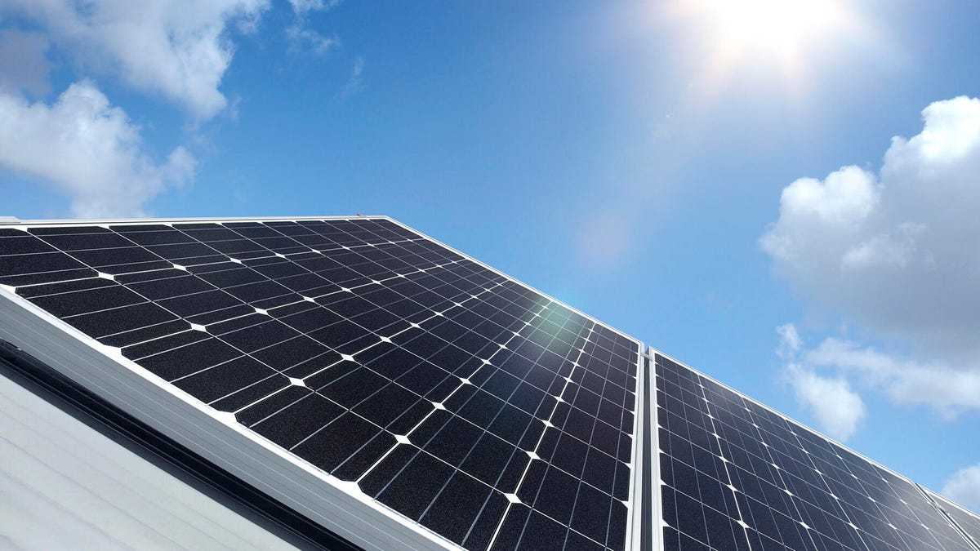
Technologies Used
What is Maximum Power Point Tracking (MPPT) :
MPPT simply means that our solar panels will always face/track sun so as to have maximum efficiency.
Principle of Sun Tracking Solar Panel: Two light dependent resistors are arranged on the edges of the solar panel. Light dependent resistors produce low resistance when light falls on them. The servo motor connected to the panel rotates the panel in the direction of Sun.

Slide 8
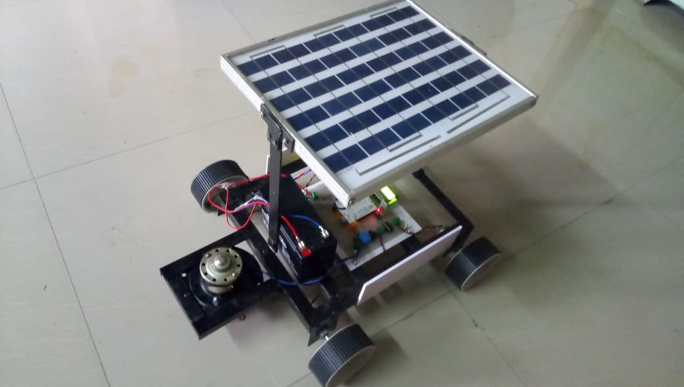
2. Communication System
We can control our solar grass cutter with the help of android, voice, message, and touch gesture using Bluetooth HC05 module and Wi-Fi module.
3. Controls System
The microcontroller Arduino-Uno based on ATmega 328 microprocessor is basically brain of our project.
To make it fully automatic we can use ultrasonics sensors to detect the obstacles in it’s path and perform it’s action without any human interruptions.

Slide 9
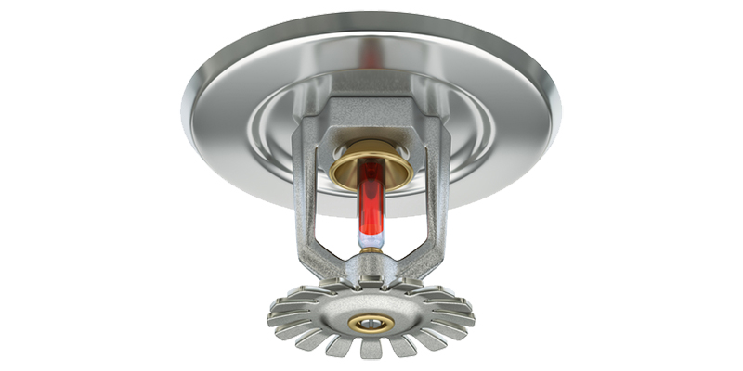
Components Used
The major components of Automated Solar Grass Cutter model are
Solar Panel
Batteries
Microcontroller
Sensors
Motor driver
DC motors and blade
Sprinkler
Sprinkler System

Slide 10
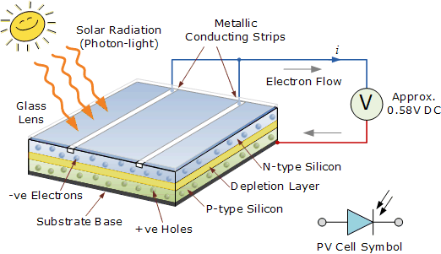
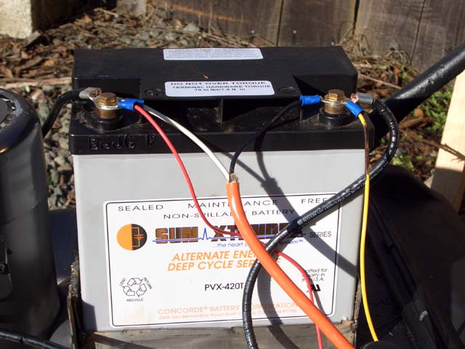
Solar Panel
When sunlight strikes a solar cell, electrons in the silicon are ejected, which results in the formation of “holes”—the vacancies left behind by the escaping electrons. If this happens in the electric field, the field will move electrons to the n-type layer and holes to the p-type layer.
Batteries
The batteries are used as a storage device for solar energy which can be further converted into electrical energy. Batteries can be in the interior of the lawn mower or on the outside.

Slide 11
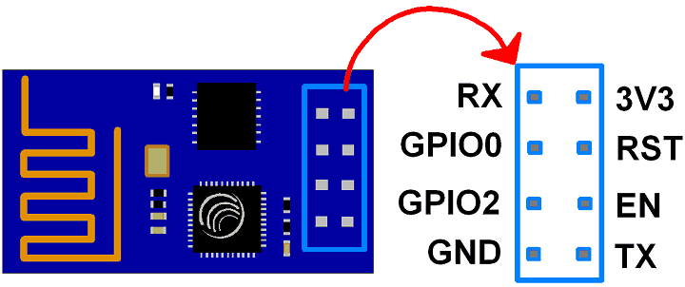
3. ESP8266-01 (WiFi Module)
ESP8266 is Wi-Fi enabled system on chip (SoC) module developed by Espressif system. ESP8266 module is low cost standalone wireless transceiver that can be used for end-point IoT developments.
Some Capabilities:
2.4 GHz Wi-Fi (802.11 b/g/n, supporting WPA/WPA2),
general-purpose input/output (16 GPIO),
Inter-Integrated Circuit (I²C) serial communication protocol,
analog-to-digital conversion (10-bit ADC)
UART (can be enabled on GPIO2), and
pulse-width modulation (PWM).
PIN Description
3V3: - 3.3 V Power Pin.
GND: - Ground Pin.
RST: - Active Low Reset Pin.
EN: - Active High Enable Pin.
TX: - Serial Transmit Pin of UART.
RX: - Serial Receive Pin of UART.
GPIO0 & GPIO2: - General Purpose I/O Pins.
ESP8266-01

Slide 12
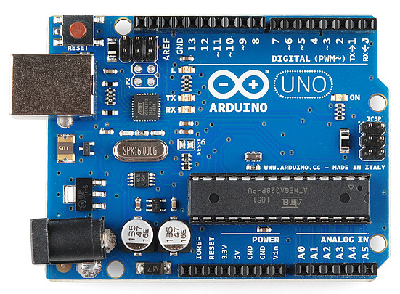

4. ARDUINO UNO
Arduino is a prototype platform (open-source) based on an easy-to-use hardware and software.
Arduino UNO is a microcontroller board based on the ATmega328P. It has 14 digital input/output pins (of which 6 can be used as PWM outputs), 6 analog inputs, a 16 MHz ceramic resonator, a USB connection, a power jack, an ICSP header and a reset button.
It consists of a circuit board, which can be programed (referred to as a microcontroller) and a ready-made software called Arduino IDE (Integrated Development Environment), which is used to write and upload the computer code to the physical board.

Slide 13
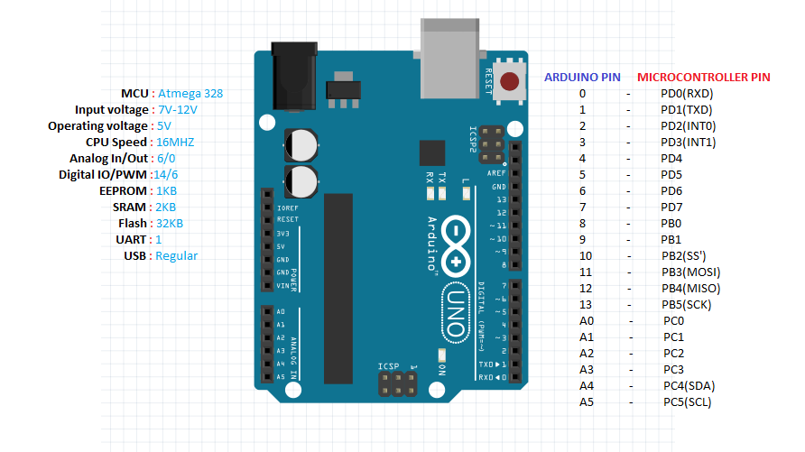
ARDUINO PIN DIAGRAM

Slide 14
Hardware and Software Used
Hardware
Arduino Uno
Solar Array
Servo Motors
DC motor
Blades
Battery
Comparator
Temperature sensor
Software
Arduino IDE
Embedded C

Slide 15
Application and Future Scope
The project has a wider range of application such as in:
In agriculture
In gardens, Big lawns
In hospital
In colleges
In nurseries
Playground like: cricket ground, football ground etc.

Slide 16
Application and Future Scope
This can be further improved by incorporating the following modifications to obtain better results:
The mechanism which we used i.e. scotch yoke mechanism does not given excepted efficiency. This efficiency can be increased by using some other mechanism.
Speed of motor is reduced because we have used heavy material and this material can be replaced by using light weight material
Design of blades should be done based on types of grass is used to cut.
The project which we have done surly reaches the average families because the grass can be trimmed with minimum cost and with minimum time. Finally, this project may give an inspiration to the people who can modify and can obtain better results.

Slide 17
Advantages
Compact size and portable
No fuel cost
No pollution
Easy to move from one place to another
Less wear and tear
Non-skilled person can also operate
The energy consumption is also handled effectively using our Solar Tracker
Sprinkler system settles the soil eroded from high rpm of blade.

Slide 18
Disadvantages
Blade failure
High Initial Costs for material
Depending on geographical location the size of the solar panels vary for the same power generation.
Manually operated
Difficult to operate in rainy seasons
Lower production in winter months and Cloudy days.
Could not differentiate between grass and small plants.

Slide 19


Slide 20
2nd Presentation
on
“Android Based Solar Grass Cutter with MPPT System and Sprinkle System”
Project Guide:
Asst. Prof Neeraj Sharma
(Department of Electronics and Communication Engineering)
Project Coordinator
Dr. Nimish Srivastava
(Department of Electronics and Communication Engineering)
Prepared By – Group PEC 3.14
Shivanshu Singhal (1900270310170)
Shubham Kr. Singh (1900270310175)
Saurabh Singh (1900270310156)
Sarvik Singh (1900270310153)
Submitted to:
Gp. Capt. (Dr) PK Chopra(R), VSM
HOD ECE & EI
Ajay Kumar Garg Engineering College, Ghaziabad
Dr A.P.J. Abdul Kalam Technical University, Lucknow

Slide 21
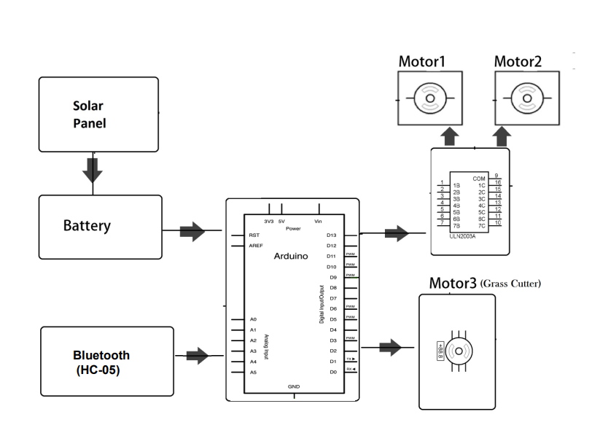
Working
The microcontroller operates the vehicle movement dc motors as well as the grass cutter at the same time as monitoring the sprinkler system.
The system also uses a gyro sensor in order to achieve perfect 180 degree turns in order to achieve complete lawn/garden coverage.
The battery is charged through the solar panels that drives the motor blades and wheels of the lawn mower.

Slide 22
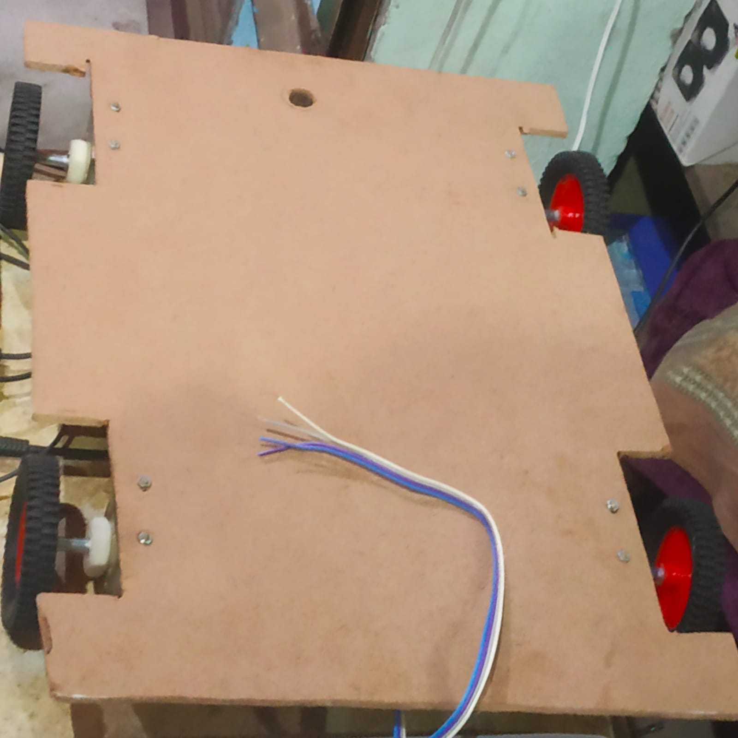
Work Done
First of all , we design the structure for our solar grass cutter and for that we used MDF (medium density fiber) as a material.
And the dimension of our Robotic Chasis is length 39cm, breadth 29 cm, and height of solar panel from the board is 25 cm.
Then we mounted the solar panel of dimension 15 x 15cm with frame and 18 x 18 cm without frame above the chasis.
After that we attached 4 wheels of diameter 6.34cm and we used L clamp to attach wheels with the MDF board and these L clamp is also used to attach the motor with the wheels
We used the solar panel of mono silicon crystalline material.

Slide 23
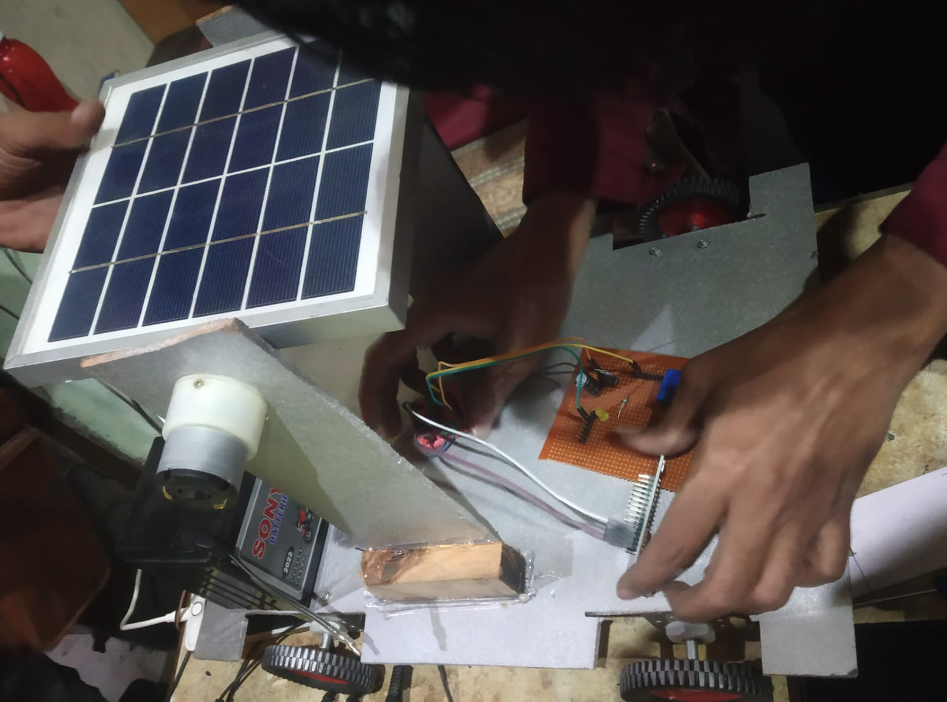
Work Done
We used an PN diode (14007) that connects between solar panel and battery, we use PN diode because we want the current to flow only in one direction(solar to battery).
And we use a 12 volts battery (provide 2.5A).
To distribute power we used a 0 PCB (printed circuit board).
On PCB board we mounted a electrolytic capacitor(1000mf) so that our signal is smooth and noise free and it can filter upto 25v.
And we also used voltage regulator (LM7805), it convert 12V power that came from battery into 5V because all the sensors and our microcontroller will work on 5V.

Slide 24
Work Done
There is a resistor of 330 ohm to operate a LED of 2.5-3.0 V.
We used a microcontroller which is brain of our project, we can drive this microcontroller by touch and voice commands using coding.
We also used a motor driver module (L29 3D module) so that our solar panel and mower can rotate both in clock wise and anti clock wise direction. This motor driver is controlled by controller.
To operate sprinkler system we design a setup which consist of a relay, a npn transistor(BC 547), and a resistor of 1kilo ohm.
And we used 2 DC gear motor (operating on 12 V) on the wheels, which rotates at 60 Rpm and 1 DC gear motor on solar panel , which rotates at 10 Rpm.

Slide 25
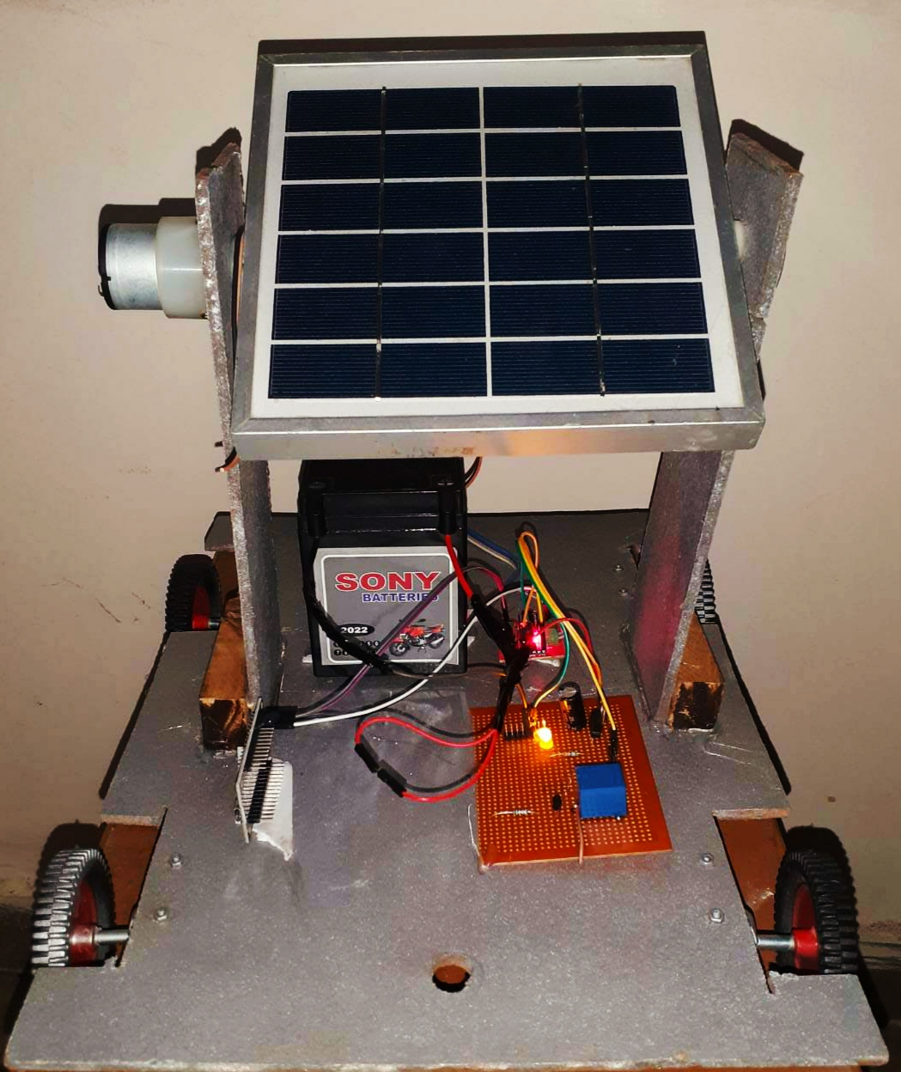
Result
We designed structure for our grass cutter.
And mounted all the components on the MDF board such as solar panel, Battery, microcontroller etc.
All the connections are done.

Slide 26
Future Work
Our microcontroller is yet to be coded, we will code our microcontroller using Arduino uno in C++ language.
LDR( Light Dependent Resistor) sensors will be fixed on the sides of solar panel to provide MPPT(maximum power point tracking).
Sprinkler system will be mounted on the grass cutter.
The grass cutter blades will be design and attach.
Bluetooth Module (HC 05) to communicate with the grass cutter is yet to attached.

